Slide 1
REDXA/MARS Field Day 2016
Friday, June 24
Saturday, June 25
Sunday, June 26
…at a new location

Slide 2
REDXA/MARS Field Day 2016
5223 Red Hill Road, Petaluma, CA
“The Monkey Ranch”

Slide 3
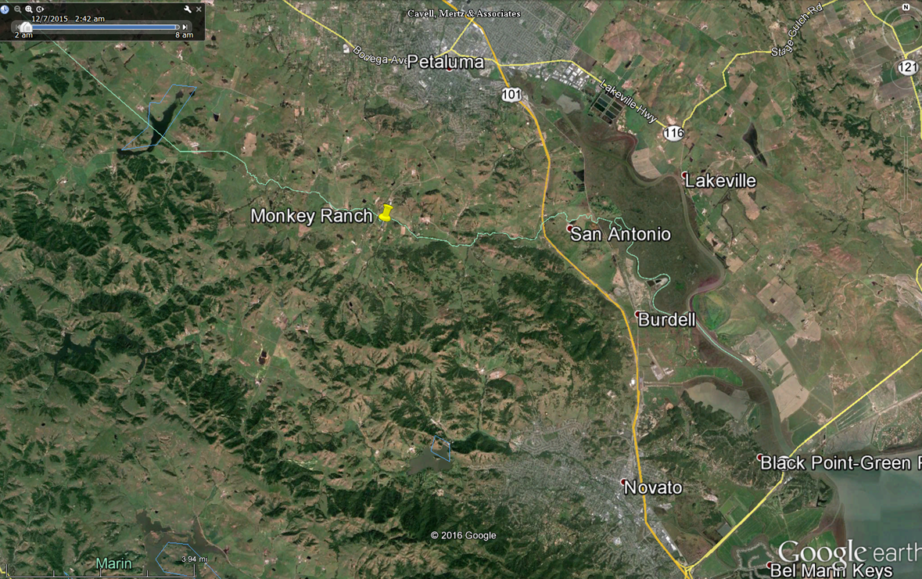
REDXA/MARS Field Day 2016

Slide 4
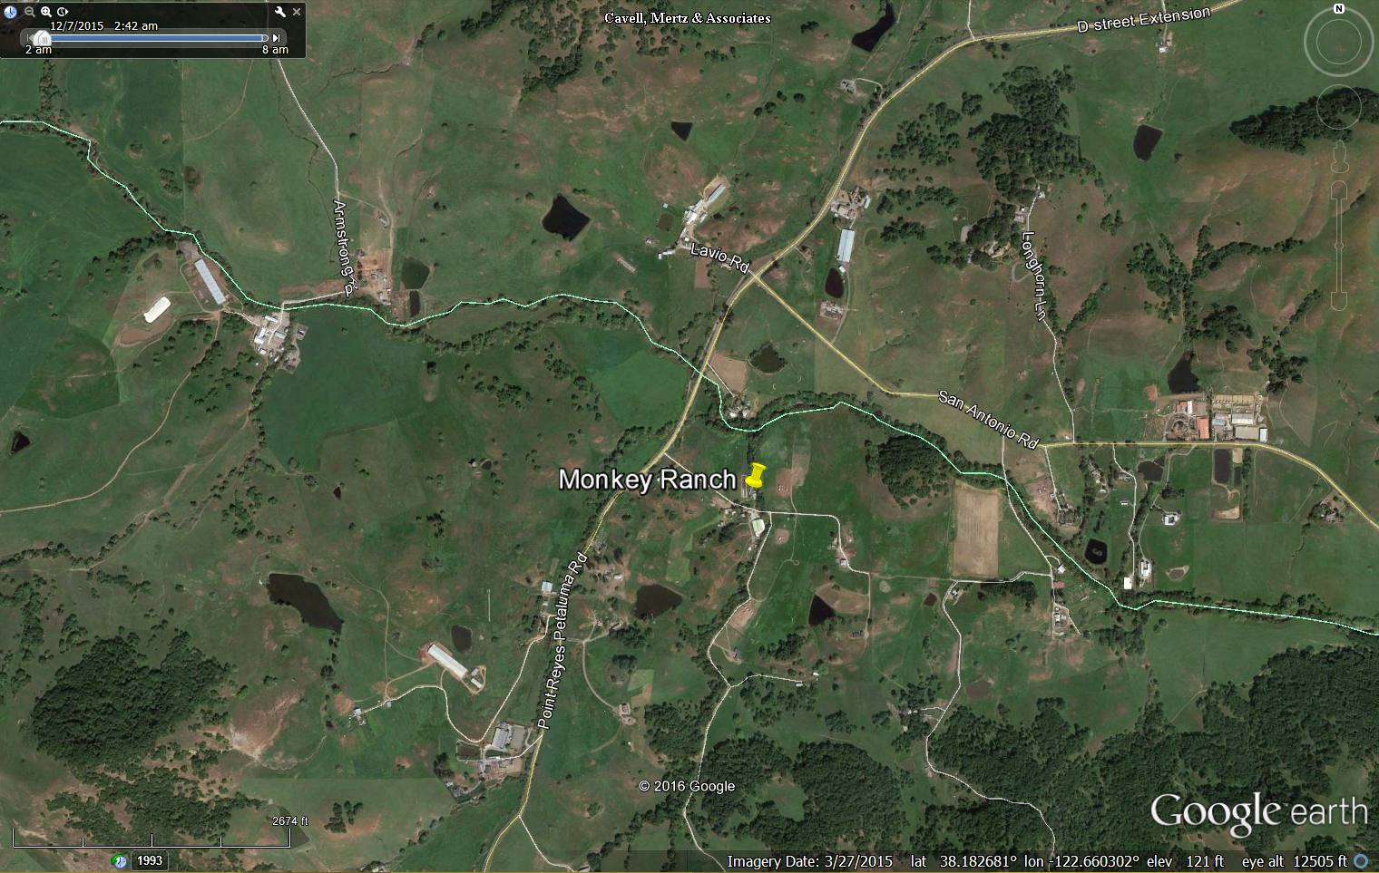
REDXA/MARS Field Day 2016

Slide 5
Site Amenities
Easy accessibility
Adequate parking
Electric
Lights
Water
Bar-B-Q
Plenty of room for antennas
Shelter
Reasonable cost

Slide 6
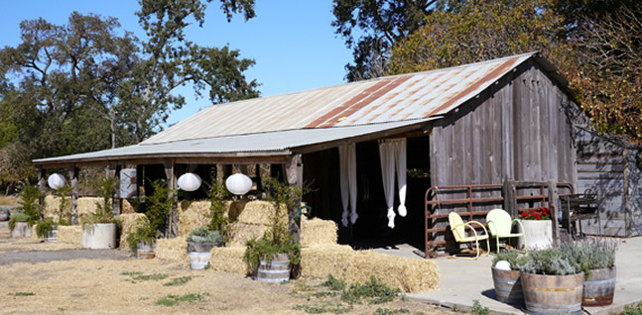
Shelter
The Party Barn

Slide 7
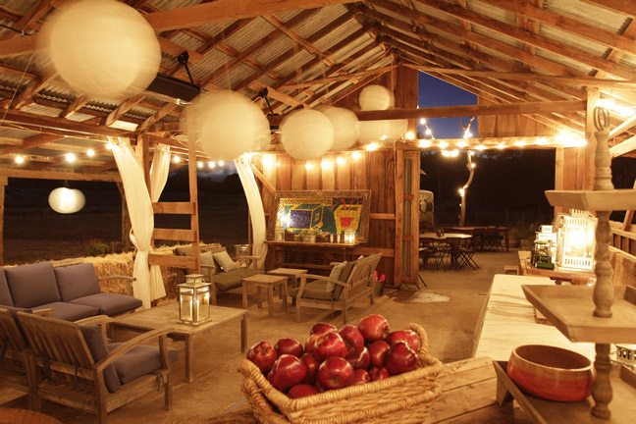
Shelter
The Party Barn

Slide 8
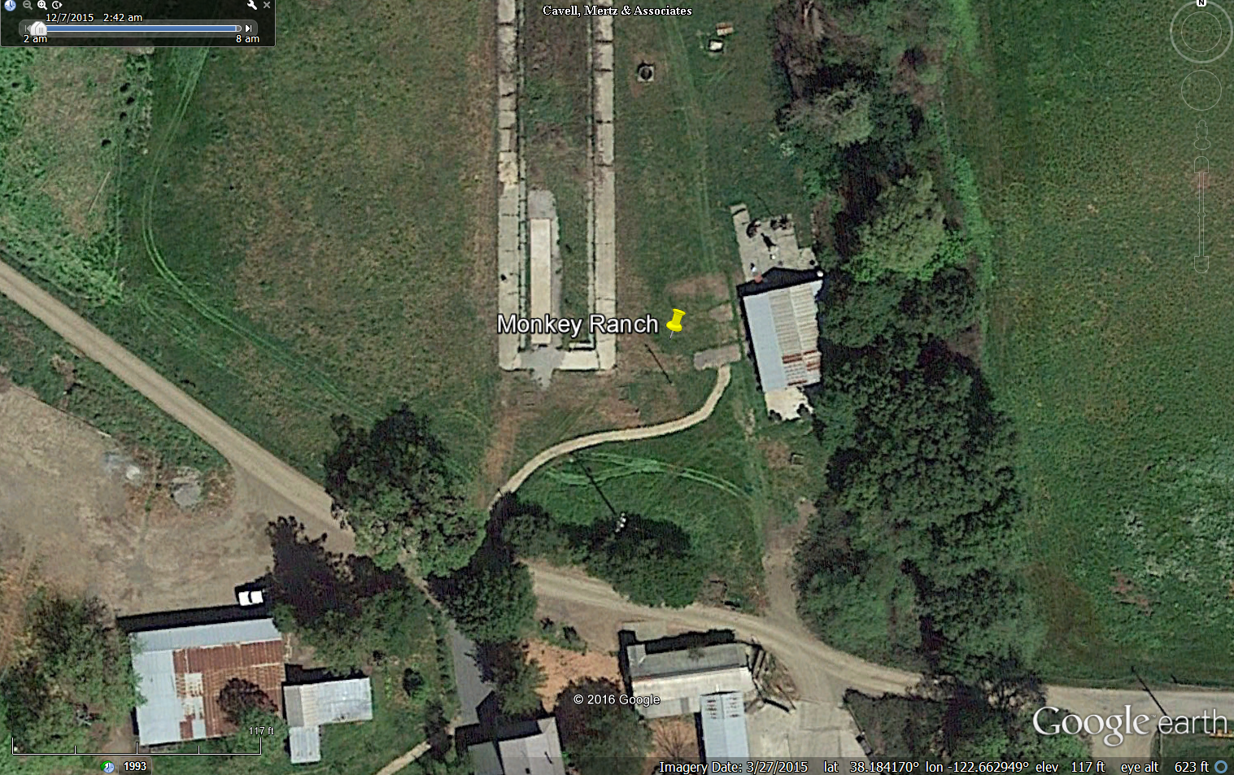
Site Map

Slide 9
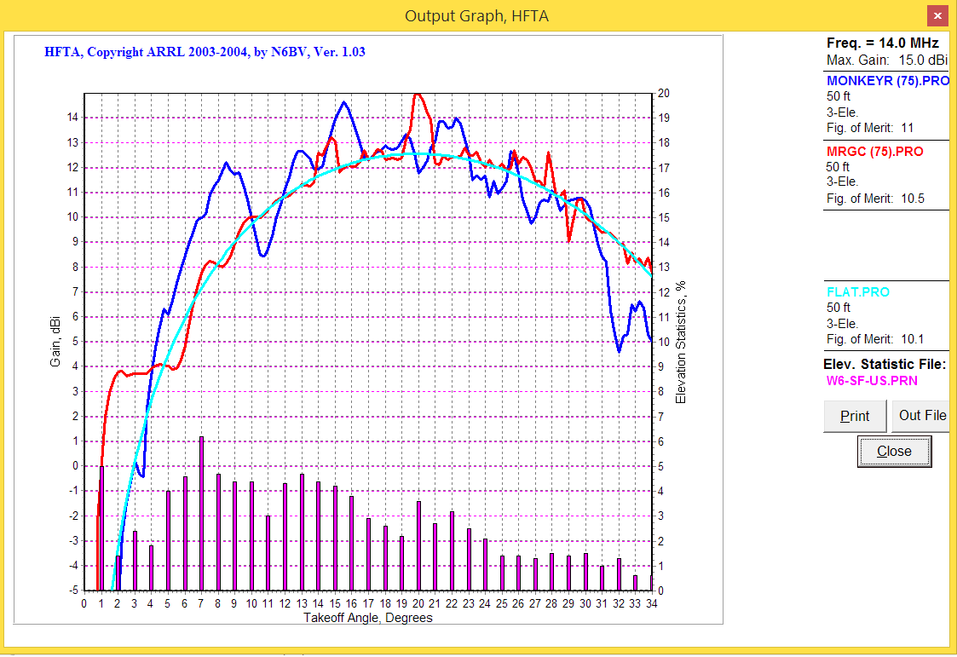
Propagation
As good or better than MR&GC

Slide 10
Field Day Scoring
Class 2A – W6SG (W6KB GOTA)
Basic Points: 1 for Phone, 2 for CW
Multiplier: x2 for low power

Slide 11
Field Day Scoring
Bonus Points
Emergency Power: 200 Points
Media Publicity: 100 Points
Public Information Table: 100 Points
Message to Section Manager: 100 Points
Message Handling: 10 per, 100 Points total
Satellite QSO (Maybe): 100 Points
Alternate Power (5 QSOs) 100 Points
Copy ARRL Bulletin: 100 Points
Educational Activity (TBD) 100 Points
Visit by ‘served agency’: 100 Points
Visit by elected official (Maybe): 100 Points
Web Submission of logs: 50 Points

Slide 12
Field Day Scoring
Bonus Points
GOTA STATION Normal Points + Bonus:
20 for each 20 QSO’s per GOTA op (100 Max per OP)
Bonus DOUBLED if there was a coach

Slide 13
Field Day Scoring
Bonus Points
GOTA STATION Normal Points + Bonus:
20 for each 20 QSO’s per GOTA op (100 Max per OP)
Bonus DOUBLED if there was a coach
Youth Participation:
Op 18 or younger: 20 points. Only one QSO needed
100 Points Max

Slide 14
Field Day Scoring
Bonus Points – New Categories
Social Media: 100 Points
Facebook page, Twitter, Instagram
Safety Officer: 100 Points
Follow Checklist in 2016 FD Package

Slide 15
Join Us for Field Day 2016!
Antenna Setup: Friday, June 24 10:00 am
Operate: Saturday, June 25 11:00 am
Break Down: Sunday, June 26, 11:00 am
Advance Operating Reservations – N6IE
(Sign-in Boards will be used)

